Slide 1
07 - Linear Regression
Machine Learning
Notes:
Hi there! Welcome to the Linear Regression section of the SMLC course! My name is Arjun, one of the SMLC leaders, and I am very excited to teach you guys everything you need to know about the Linear Regression machine learning model!

Slide 2
Course Overview:
1.1 - Python Review
1.2 - Numpy
1.3 - Pandas
1.4 - Seaborn
2.1 - ML Intro
2.2 - Linear Regression
2.3 - Logistic Regression
2.4 -Naïve Bayes Classifier
2.5 - KNN
2.6 - Decision Trees
3.1 – Ensembling Learning
3.2 - Neural Networks
4.* - Natural Language Processing (NLP)
5.* Competition Tips & Final Thoughts

Slide 3
Linear Regression Theory
01
Explaining OLS
02
Implementation
TABLE OF CONTENTS
03
Understanding the linear regression model
Explaining the method that produces the best-fit line on the data
Utilizing a real house prices dataset from Scikit Learn
Notes:
Before we begin with the content, I want to give a brief overview of the lecture videos that I am going to be covering in this linear regression section of the course.
The first video, the one you are watching right now, will be covering the theory behind the Linear Regression model. In this lecture, we are going to understand the ideas and applications behind model and ensure that you have a good theoretical basis behind it.
In the second lecture video, we are going to learn more in-depth about the mathematical underpinnings behind linear regression by covering the OLS method (OLS stands for ordinary least squares). OLS is essentially the method that produces the line of best-fit that linear regression is all about, and we're going to go over the specifics of it in that lecture video.
Finally, for the last lecture video, we will go over the python implementation for linear regression by utilizing a real house prices dataset offered by the Scikit Learn machine learning library.

Slide 4
01
Linear Regression Theory
Understanding the linear regression model
Notes:
So without further ado, let's get started with understanding the theory behind the linear regression machine learning algorithm.

Slide 5
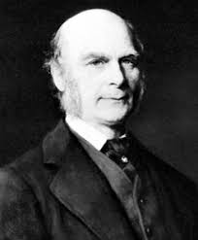
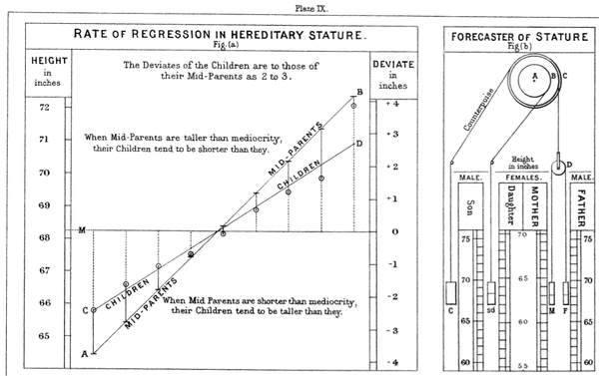
Francis Galton and the Idea of Regression
Galton closely studied the relationship between the heights of fathers and their sons
Discovered that the man’s sons tended to be roughly as tall as the father
Breakthrough: son’s height tended to be closer to the average height of all people
Called this phenomenon regression → A son’s height tended to regress towards the average height
https://www.britannica.com/biography/Francis-Galton
Notes:
a. Galton closely studied the relationship between parents and their children → in particular, he investigated the relationship between the heights of fathers and their sons
Discovered that the man’s son tended to be roughly as tall as his father
Galton’s breakthrough was that the son’s height tended to be closer to the overall average height of all people (the population)
Galton called this phenomenon regression, as in “A father’s son’s height tends to regress (or drift towards) the mean (average) height

Slide 6
Figure of Dalton’s Findings
https://www.bogleheads.org/wiki/Regression_to_the_mean
Notes:
In this diagram, we can get a better visual of Dalton's work:
We can see how the height of children is regressing or deviating to the average or mean height of the population

Slide 7

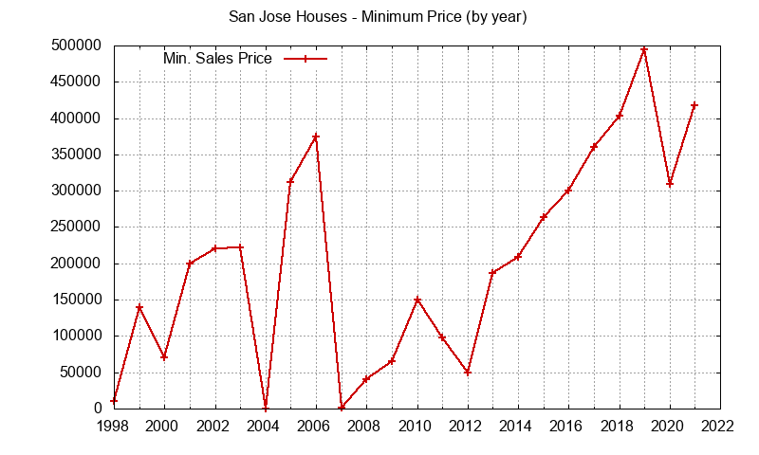
What is Linear Regression?
Linear regression is a supervised learning model for regression tasks → predicting target values that are numerical/continuous in nature given a set of inputs
Some applications of linear regression:
Stock prices
Cost of tickets
Housing prices
Company's profit estimation
https://vocal.media/trader/the-highest-stock-prices-in-history
https://julianalee.com/san-jose/san-jose-statistics.htm

Slide 8
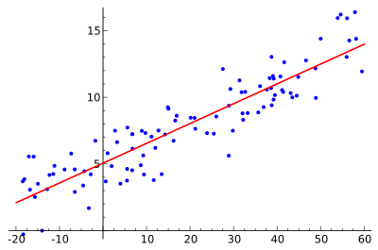
Goal of Linear Regression
Goal of linear regression: training a best-fit line on a set of data points
When we calculate our regression line, we are trying to draw a line that is as close to every data point as possible to reduce the loss
Minimizing the vertical distance between data points and our line (residuals)
Method: OLS (Ordinary Least Squares)
Best-fit line establishes the relationship between dependent and independent variables
https://en.wikipedia.org/wiki/Linear_regression
Notes:
Goal of linear regression: training a best-fit line on a set of data points
When we calculate our regression line, we are trying to draw a line that is as close to every data point as possible to reduce the loss (or in other words, the error)
This essentially means that we are trying to minimize the vertical distance between data points and our line (this distance between the observed data point and the predicted value of the line of best fit is called the residual)
Method to calculate and train a best-fit line is called OLS (Ordinary Least Squares) → I'll be covering this in the next video
Main takeaway: The Best-fit line establishes the relationship between dependent and independent variables

Slide 9
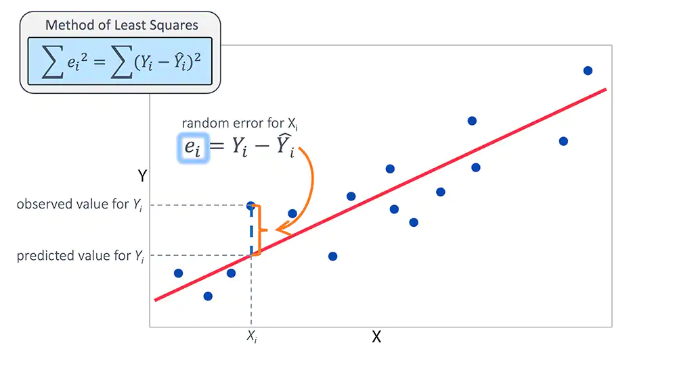
Goal of Linear Regression Continued
https://www.jmp.com/en_hk/statistics-knowledge-portal/what-is-multiple-regression/fitting-multiple-regression-model.html
Notes:
This image gives a more clear view of residuals (the error) and the best-fit line

Slide 10
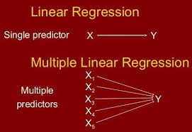
Two Types of Linear Regression
Two types of linear regression
Simple linear regression → One feature and a target
Multiple linear regression → N features and a target
https://medium.datadriveninvestor.com/types-of-linear-regression-89f3bef3a0c7
Notes:
Two types of linear regression
Features are the independent variables or the attributes, factors, and information that serve as the inputs that your model can use to help make a prediction. The idea is that the model will see correlations between these independent variables and your target variable that you are trying to predict (ex. price of an item)
For example, let's think of a linear regression model that's trying to predict the cost of ice cream
If the model is a type of simple linear regression, that means we are only using one feature or independent variable to help train our model to make predictions → this one feature could be the weather, since the hotter weather has correlations to higher prices of ice cream since more people will want to buy ice cream when it's hot
If the model is a type of multiple linear regression, then we're not just going to have one feature, we will have multiple, N# of features and our target variable (which is the price of ice cream) → so our set of features will be not only the weather, but it could also be location, competition, population size, etc. factors like that which can prove to be useful information when making the prediction of the dependent variable
Simple linear regression → There is one feature and a target
Multiple linear regression → There are n features and a target

Slide 11
02
Explaining OLS
Explaining the method that produces the best-fit line on the data
Notes:
I hope this lecture proved useful in teaching you the basics and foundation of linear regression.
In the next video, Explaining OLS, we are going to be covering more in-depth about this statistical method and get a better mathematical sense behind the Linear Regression Algorithm.
Hi there, welcome to the second lecture video of the linear regression section of the SMLC course. In this video, we're now going to learn about Ordinary Least Squares (or OLS for short)

Slide 12
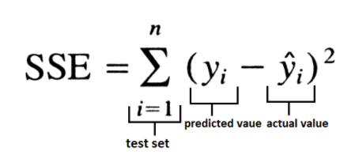
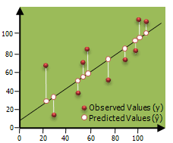
What is Ordinary Least Squares (OLS)?
OLS is the statistical method that produces the one straight best-fit line that minimizes the total squared error
A method to fit a best-fit line to our data
Goal: Calculating a line that minimizes the distances between predicted and observed values (loss)
OLS regression is fitted by minimizing the sum of squares of the residuals
Residual = observed - predicted
We square because some data points are below and above the line
towardsdatascience.com
https://www.obieetips.com/2019/02/v-behaviorurldefaultvmlo.html
Notes:
OLS is the statistical method that produces the one straight line that minimizes the total squared error
A method to fit a best-fit line to our data
Goal: Calculating a line of best fit that minimizes the distances between predicted and observed values (residuals, loss, error)
OLS regression is fitted by minimizing the sum of squares of the residuals
Residual = difference between observed (y-value) and expected/predicted value on our best-fit line
We square because some data points are below and above the line → means that the difference between observed and expected can be + or -

Slide 13
Optional Video To Better Understand Some of the Math Behind OLS
https://www.youtube.com/watch?v=szXbuO3bVRk

Slide 14

Advantages of OLS Regression
Good to use for inherent linear relationship between independent and dependent variables
Simple implement and interpret
Good results can be obtained with relatively small datasets
https://www.itprotoday.com/cloud-computing/virtual-machine-advantages-4-reasons-keep-loving-vms
Notes:
This algorithm is best to use when you know there is an inherent linear relationship between independent and dependent variables → due to the fact that in such a linear relationship, this algorithm will have less complexity compared to other algorithms
Easy to implement and interpret
Good results can be obtained with relatively small datasets → this is good because sometimes your datasets won't always be large, substantial, and filled with useful features, and even with a smaller data set, you can still train an effective linear regression model

Slide 15

Limits and Disadvantages of OLS Regression
Limited to linear relationships → oversimplification
Very sensitive to outliers
Only looks at the relationship between mean of the dependent variables and the independent variables
Multicollinearity (redundancy) between x-variables
ipwatchdog.com
Notes:
Limited to linear relationships → by its nature, linear regression only looks at the linear relationships between independent and dependent variables (this is good if data is inherently linear and can be well described by a linear model)→ however, linear regression always assumes that there is a straight line relationship between them, which can sometimes be incorrect → for instance, sometimes the relationship between independent and dependent variables can be curved in nature (or inherently non-linear) → ultimately, this means that using linear regression can sometimes lead to oversimplification
Linear regression algorithm is especially sensitive to outliers, since we are squaring residuals → outliers can have a huge effect on the regression performance because they can skew the best-fit line, which will ultimately skew the predictions → also makes it prone to noise and overfitting
Since linear regression is based on a line of best fit, it only looks at the relationship between mean of the dependent variables and the independent variables → Just as the mean is not a complete description of a single variable, linear regression is not a complete description of relationships among variables.
Multicollinearity (redundancy → high correlations between two or more independent-variables/features) between x-variables can lead to misinterpretation when making predictions and can skew model results → furthermore, the redundancy is not introducing any new, valuable information that the model can learn from to perform better with the complexities of new data → also, this redundancy makes it difficult to understand and differentiate the individual effects of one feature on the target variable and the individual effects of the other, redundant feature on the target variable since both of those features are so similar and highly correlated → this means that it will be difficult to determine which features will be most beneficial to help our model learn properly from the data and make accurate predictions on new data

Slide 16
03
Implementation
Walkthrough of Linear Regression with Python
Notes:
And that was the lecture video on OLS! In the next lecture we'll be using SciKit-Learn and Python to implement a linear regression model, and we'll be training our model with a real boston house prices dataset.
Thanks everyone, and I'll see you in the next lecture!
Hello everyone, and welcome to the third video of the linear regression section.

Slide 17
Implementation
Using the Boston house prices dataset from Scikit Learn, let’s now walk through the implementation for the linear regression model
Information and documentation for the dataset can be found from this link: https://scikit-learn.org/stable/modules/generated/sklearn.datasets.load_boston.html#sklearn.datasets.load_boston
Notes:
In this video we're going to cover the python implementation for the Linear Regression model. We'll do this by working with a real boston house prices dataset provided by the Scikit Learn library. Based off of the features in this dataset create a model that can predict house prices in the Boston area.
So now without further ado, let's go to the google colab and get started on linear regression with python

Slide 18
THANKS

